Slide 1
Classification of
Shoulder Implants
AI/ML Fall 2020
Team MnM
Manny Lazalde, Ivy (Nuo) Chen, Michael Vinciguerra
Mentor: Akanksh Shetty

Slide 2
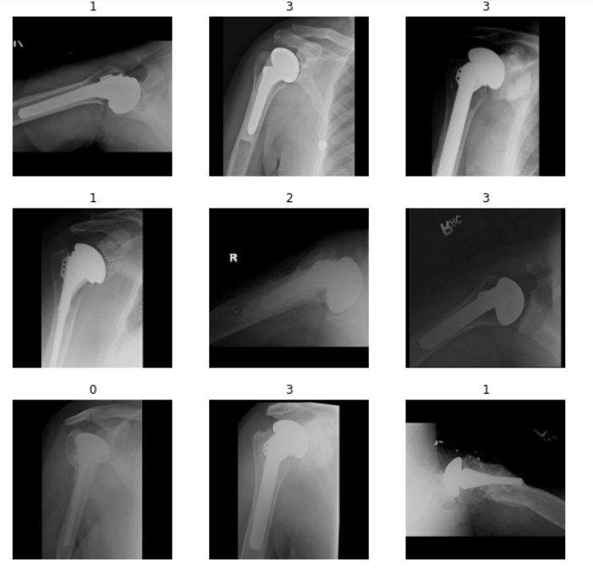
Problem & Dataset
Tornier
Cofield
Unknown Shoulder Implant Model
X-Ray Dataset from University of Washington
~600 X-Ray Images
4 Manufacturers
Class Imbalance
Depuy
Zimmer
Notes:
DATASET
Classifying X-Ray images
Shallow and deep methods
Classifying X-ray images of shoulder implants by manufacturer
Why important?
Shoulder implant classification is a major issue when a patient needs work done on the implant and the medical records do not indicate which manufacturer made the implant
X-rays are typically taken of the patient’s shoulder and significant medical expertise and time must be employed to correctly identify the corresponding manufacturer
This problem could be solved faster and cheaper with the use of ML
A group of researchers from UCSF have been investigating this problem and have posted the data set and paper on the UCI repository
Within the dataset, there are about 150 X-ray images per the 4 manufacturers, resulting in about 600 images for a 4 class classification problem.

Slide 3
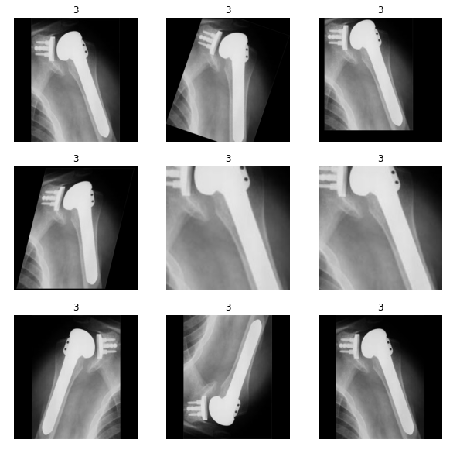
Methodology
Augmented Data
Shallow Methods
Deep Learning
Data Augmentation
Transfer Learning
Notes:
Introduction/Motivation
Dataset
Conclusions

Slide 4
Classification Results
Classifier | Augmented Data? | Accuracy | F1-Score
Random Forest | No | 55% | 0.36
Random Forest | Yes | 52% | 0.24
Logistic Regression | No | 47% | 0.34
Logistic Regression | Yes | 42% | 0.22
KNN | No | 51% | 0.25
KNN | Yes | 50% | 0.33
Resnet 50 | No | 48% | 0.41
Resnet 50 - Transfer Learning | No | 67% | 0.62
Resnet 50 - Transfer Learning | Yes | 91% | 0.90
Notes:
K Fold cross validation

Slide 5
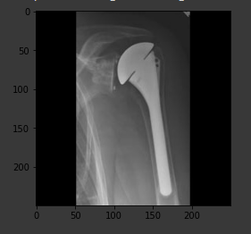
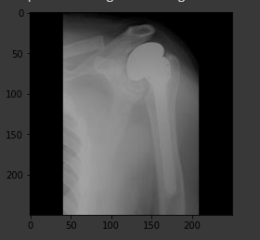
Results and Conclusion
Deep Learning Methods Best
Power of Transfer Learning
Quantity of Data Issues
Shallow Methods Ineffective
Able to Use Deep Learning to Classify Shoulder Implants
Tornier
Cofield
Notes:
Introduction/Motivation
Dataset
Conclusions

